Slide 1

ICBP 2.0
Carbon Footprint Optimization in Supply Chain Logistics
Your Name : UMAMAHESWARI R
Project GitHub Link: https://github.com/radhauma/Carbon-Footprint-Optimization-in-Supply-Chain-Logistics

Slide 2
Content
Problem Statement
Objective
Dataset
Exploratory Data Analysis (EDA)
Model Selection
Model Architecture (For Deep Learning Projects)
Training & Evaluation
Results
Conclusion & Future Work
References
Notes:
Problem Statement
Objective
Dataset
Exploratory Data Analysis (EDA)
Model Selection
Model Architecture (For Deep Learning Projects)
Training & Evaluation
Results
Conclusion & Future Work
References

Slide 3
Problem Statement
The Challenge: Vehicular carbon dioxide (CO2) emissions are a significant contributor to greenhouse gases and climate change.
Need for Prediction: Accurately predicting CO2 emissions based on vehicle characteristics is crucial for:
Environmental policy-making and regulation.
Informing consumer choices towards more eco-friendly vehicles.
Automotive manufacturers in designing more fuel-efficient and lower-emission vehicles.
Complexity: CO2 emissions depend on a variety of inter-related vehicle specifications and fuel consumption patterns.
Notes:
The Challenge: Vehicular carbon dioxide (CO2) emissions are a significant contributor to greenhouse gases and climate change.
Need for Prediction: Accurately predicting CO2 emissions based on vehicle characteristics is crucial for:
Environmental policy-making and regulation.
Informing consumer choices towards more eco-friendly vehicles.
Automotive manufacturers in designing more fuel-efficient and lower-emission vehicles.
Complexity: CO2 emissions depend on a variety of inter-related vehicle specifications and fuel consumption patterns.

Slide 4
Objective
Primary Goal: To develop a deep learning model capable of accurately predicting CO2 emissions (g/km) for vehicles based on their specifications.
Specific Aims:
Perform Exploratory Data Analysis (EDA) to understand the dataset and feature relationships.
Preprocess the data, handling categorical features and scaling numerical features.
Build, train, and evaluate a Neural Network model.
Assess the model's performance using appropriate regression metrics (MAE, RMSE).
Notes:
Primary Goal: To develop a deep learning model capable of accurately predicting CO2 emissions (g/km) for vehicles based on their specifications.
Specific Aims:
Perform Exploratory Data Analysis (EDA) to understand the dataset and feature relationships.
Preprocess the data, handling categorical features and scaling numerical features.
Build, train, and evaluate a Neural Network model.
Assess the model's performance using appropriate regression metrics (MAE, RMSE).

Slide 5
Dataset
Source: CO2_Emissions_Canada.csv
Contains specifications and CO2 emission data for various vehicle models.
Size:
7385 entries (vehicles)
12 original columns
Key Features (Original):
Make, Model, Vehicle Class (Categorical)
Engine Size(L), Cylinders (Numerical)
Transmission, Fuel Type (Categorical)
Fuel Consumption City (L/100 km), Fuel Consumption Hwy (L/100 km), Fuel Consumption Comb (L/100 km), Fuel Consumption Comb (mpg) (Numerical)
Target Variable: CO2 Emissions(g/km) (Numerical)
Data Quality: The dataset was complete with no missing values across all 7385 entries.
Initial Cleaning: Column names were standardized (e.g., "Engine Size(L)" to "Engine_Size_L") for easier processing.
Notes:
Source: CO2_Emissions_Canada.csv
Contains specifications and CO2 emission data for various vehicle models.
Size:
7385 entries (vehicles)
12 original columns
Key Features (Original):
Make, Model, Vehicle Class (Categorical)
Engine Size(L), Cylinders (Numerical)
Transmission, Fuel Type (Categorical)
Fuel Consumption City (L/100 km), Fuel Consumption Hwy (L/100 km), Fuel Consumption Comb (L/100 km), Fuel Consumption Comb (mpg) (Numerical)
Target Variable: CO2 Emissions(g/km) (Numerical)
Data Quality: The dataset was complete with no missing values across all 7385 entries.
Initial Cleaning: Column names were standardized (e.g., "Engine Size(L)" to "Engine_Size_L") for easier processing.

Slide 6
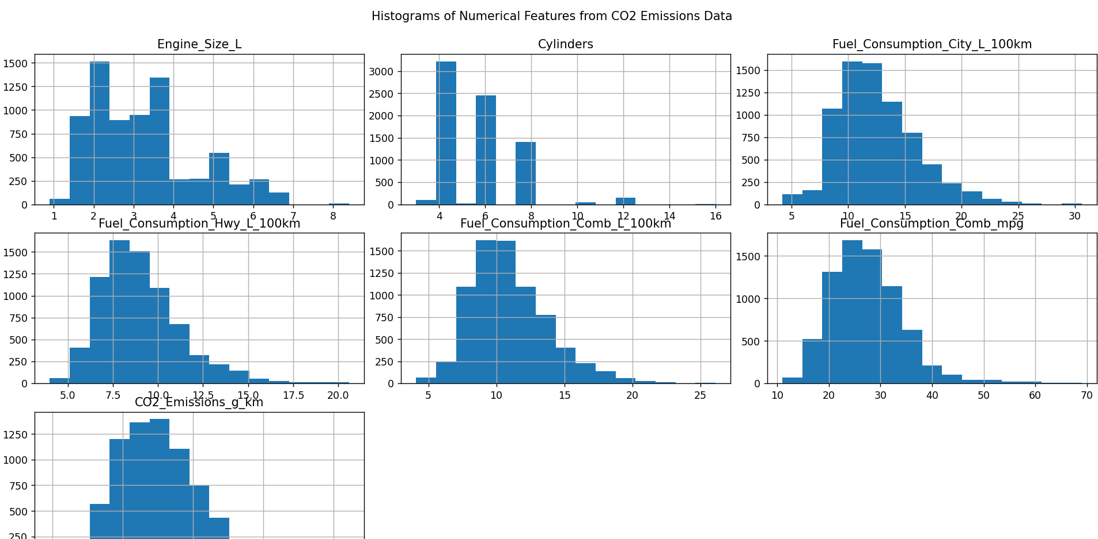
Exploratory Data Analysis (EDA)
Numerical Features
Notes:
Key Observations from Numerical Features:
Engine Size (L): Most vehicles have engine sizes between 1.5L and 4.0L, with a peak around 2.0L and another around 3.5L. Some larger engines up to 8.4L exist.
Cylinders: Dominated by 4-cylinder and 6-cylinder engines. 8-cylinder engines are also common. Fewer vehicles with 3, 5, 10, 12, or 16 cylinders.
Fuel Consumption (City, Hwy, Comb L/100km): All show right-skewed distributions, with most vehicles having lower consumption values.
Fuel Consumption (Comb mpg): Shows a left-skewed distribution (inverse relationship with L/100km), with a peak around 25-35 mpg.
CO2 Emissions (g/km): Appears somewhat normally distributed but with a slight right skew. Most vehicles emit between 200-300 g/km. The range is from 96 g/km to 522 g/km.
Descriptive Statistics:
Average CO2 Emissions: 250.58 g/km (Std: 58.51 g/km)
Median CO2 Emissions: 246 g/km

Slide 7
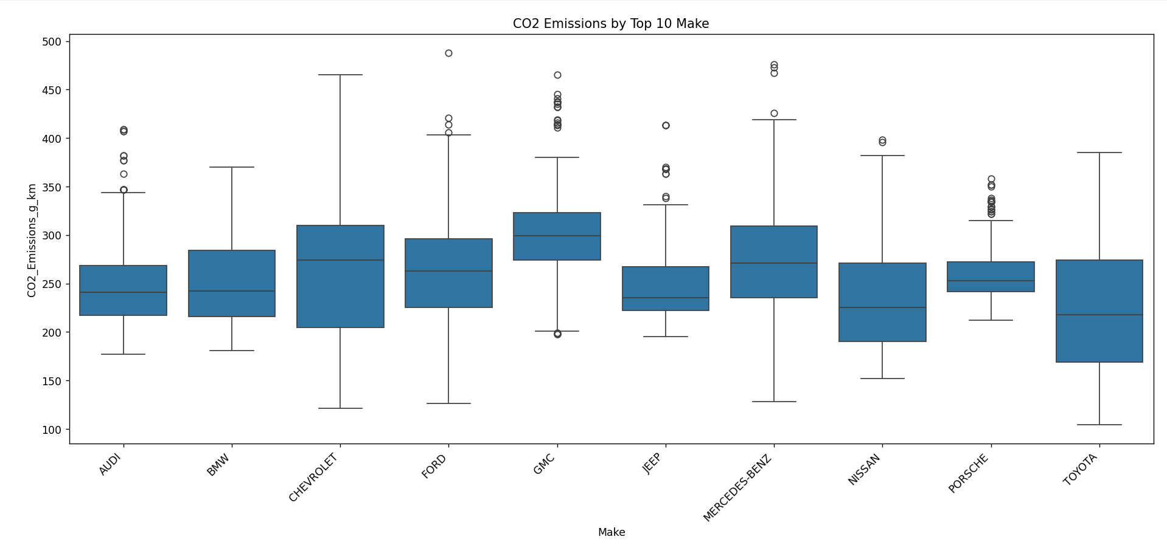
Exploratory Data Analysis (EDA)
Categorical Features & Correlations(CO2 Emissions by Top 10 Make- boxplot)
Notes:
Make: Different makes show varying median CO2 emissions and spread (e.g., GMC, Chevrolet, Ford tend to have higher median emissions among the top 10 shown, while Audi, BMW are lower).

Slide 8
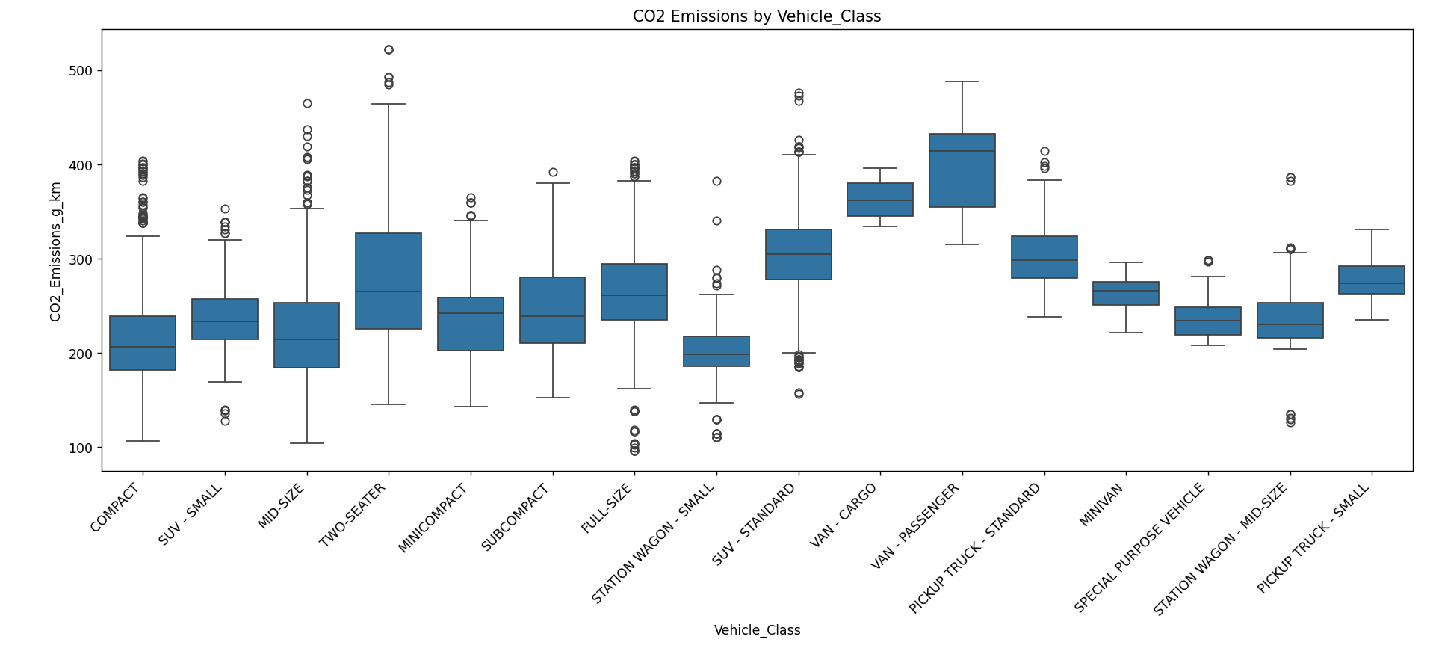
Exploratory Data Analysis (EDA)
Categorical Features & Correlations (CO2 Emissions by Vehicle_Class – boxplot)
Notes:
Clear differences observed. Larger vehicles like "SUV - STANDARD", "VAN - PASSENGER", "PICKUP TRUCK - STANDARD" generally have higher CO2 emissions compared to "COMPACT" or "MID-SIZE". "TWO-SEATER" and "MINICOMPACT" show a wide range.

Slide 9
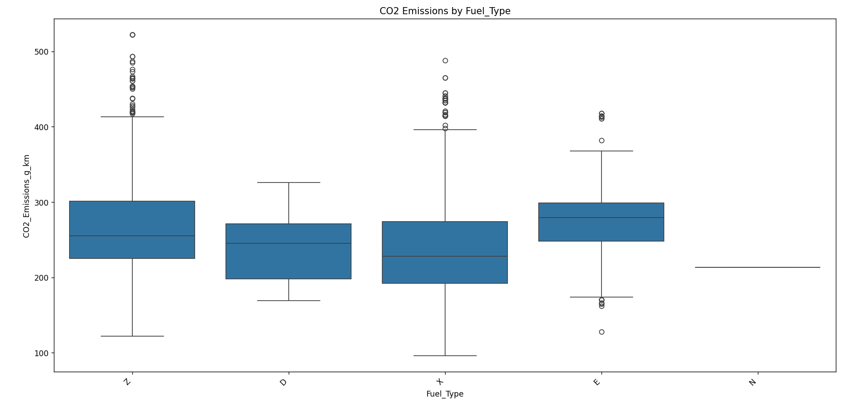
Exploratory Data Analysis (EDA)
Categorical Features & Correlations(CO2 Emissions by Fuel_Type - boxplot)
Notes:
'X' (Regular gasoline) and 'Z' (Premium gasoline) show similar, wide distributions.
'E' (Ethanol E85) shows higher median emissions when used.
'D' (Diesel) generally has comparable or slightly lower CO2 emissions for similar consumption levels (though fewer data points).
'N' (Natural gas) has the lowest CO2 emissions (very few samples). Transmission: Skipped detailed boxplot due to high cardinality (27 types), but different transmission types would likely influence fuel efficiency and thus emissions.

Slide 10
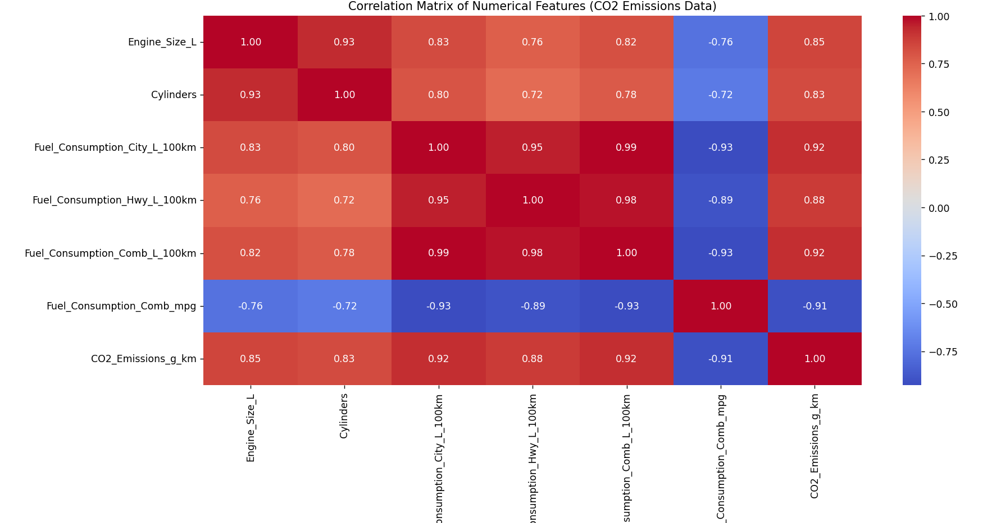
Exploratory Data Analysis (EDA)
Categorical Features & Correlations(Correlation Matrix of Numerical Features - heatmap)
Notes:
Key Observations from Correlation Matrix:
Strong Positive Correlation with CO2 Emissions:
Fuel_Consumption_Comb_L_100km (0.92) - Very strong, as expected.
Fuel_Consumption_City_L_100km (0.92)
Fuel_Consumption_Hwy_L_100km (0.88)
Engine_Size_L (0.85)
Cylinders (0.83)
Strong Negative Correlation with CO2 Emissions:
Fuel_Consumption_Comb_mpg (-0.91) - Inverse of L/100km, as expected.
High multicollinearity observed among fuel consumption metrics.

Slide 11
Model Architecture (For Deep Learning Projects)
Model Choice: A Deep Learning model (Feedforward Neural Network) was selected.
Rationale: Capable of learning complex, non-linear relationships between vehicle features and CO2 emissions.
Target Variable: CO2_Emissions_g_km
Feature Selection for Model:
Numerical: Engine_Size_L, Cylinders, Fuel_Consumption_City_L_100km, Fuel_Consumption_Hwy_L_100km, Fuel_Consumption_Comb_L_100km, Fuel_Consumption_Comb_mpg.
Categorical: Make, Vehicle_Class, Transmission, Fuel_Type.
Excluded Model due to very high cardinality.
Preprocessing Steps:
Numerical Features:
SimpleImputer (strategy='mean'): Applied, though no NaNs were in the original dataset used for this run.
StandardScaler: To scale features to have zero mean and unit variance.
Categorical Features:
SimpleImputer (strategy='most_frequent'): Applied for robustness.
OneHotEncoder: To convert categorical variables into a numerical format suitable for the neural network. This resulted in an increase in feature dimensions.
Processed Features: After preprocessing, the input features for the model expanded to 95 columns.
Notes:
Need to discuss about :
Layers used (Conv, Pool, Dense, Dropout)
Diagram of architecture
Parameters/Hyperparameters

Slide 12
Model Architecture (For Deep Learning Projects)
Type: Sequential Feedforward Neural Network
Input Layer:
Shape: 95 features (derived from preprocessed data)
Hidden Layers:
Layer 1: Dense layer with 128 neurons, ReLU activation.
Dropout layer with a rate of 0.3 (to prevent overfitting).
Layer 2: Dense layer with 64 neurons, ReLU activation.
Dropout layer with a rate of 0.3.
Layer 3: Dense layer with 32 neurons, ReLU activation.
Output Layer:
Dense layer with 1 neuron, linear activation (for regression task).
Total Parameters: 22,657 (all trainable)
Notes:
Need to discuss about :
Layers used (Conv, Pool, Dense, Dropout)
Diagram of architecture
Parameters/Hyperparameters

Slide 13
Training & Evaluation
Data Splitting:
Training set: 5169 samples
Validation set: 1108 samples
Test set: 1108 samples
Training Configuration:
Optimizer: Adam (learning rate = 0.001)
Loss Function: Mean Squared Error (MSE)
Metrics: Mean Absolute Error (MAE), MSE
Epochs: Maximum 150, Batch Size: 32
Callbacks: EarlyStopping (monitor='val_loss', patience=15, restore_best_weights=True)
Notes:
Need to discuss about :
Training strategy
Loss function & optimizer
Accuracy, precision, recall, F1 score, confusion matrix

Slide 14
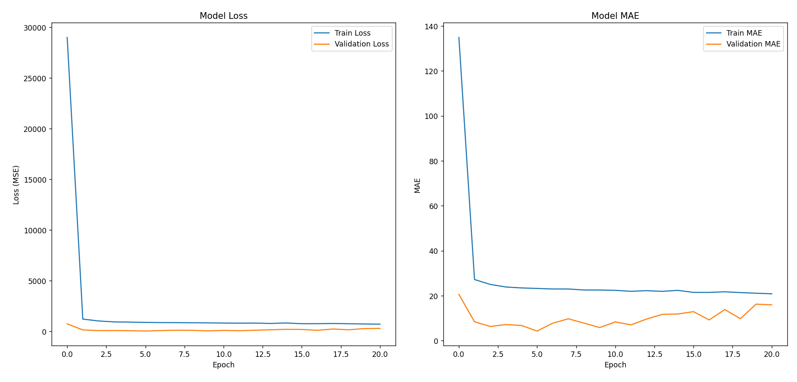
Training & Evaluation
Training Process:
Notes:
Training stopped at Epoch 21 due to early stopping.
The best model weights (lowest validation loss of 33.70) were restored from Epoch 6.
This indicates effective prevention of overfitting.

Slide 15
Results
Test Set Performance:
Test Loss (MSE): 38.32
Test Mean Absolute Error (MAE): 4.59 g CO2/km
Interpretation: On average, the model's CO2 emission predictions are off by approximately 4.59 g/km from the actual values on unseen test data.
Test Root Mean Squared Error (RMSE): 6.19 g CO2/km
Interpretation: Provides another measure of prediction error in the same units as the target, penalizing larger errors more.
Notes:
Need to discuss about :
Visuals (graphs, images, etc.)
Comparison with baseline models (if any)
Inference speed, model size (for DL)

Slide 16
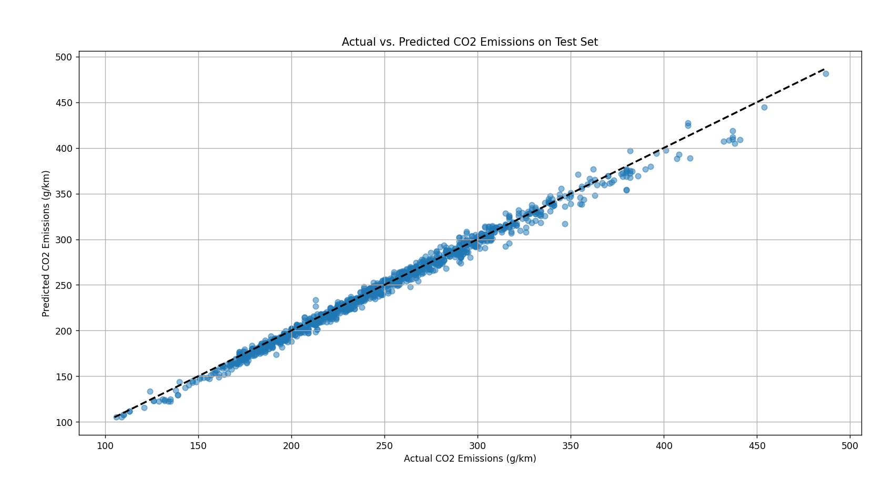
Results
Notes:
The plot shows a strong linear relationship, with most points clustering tightly around the diagonal (y=x) line, indicating good predictive accuracy.

Slide 17
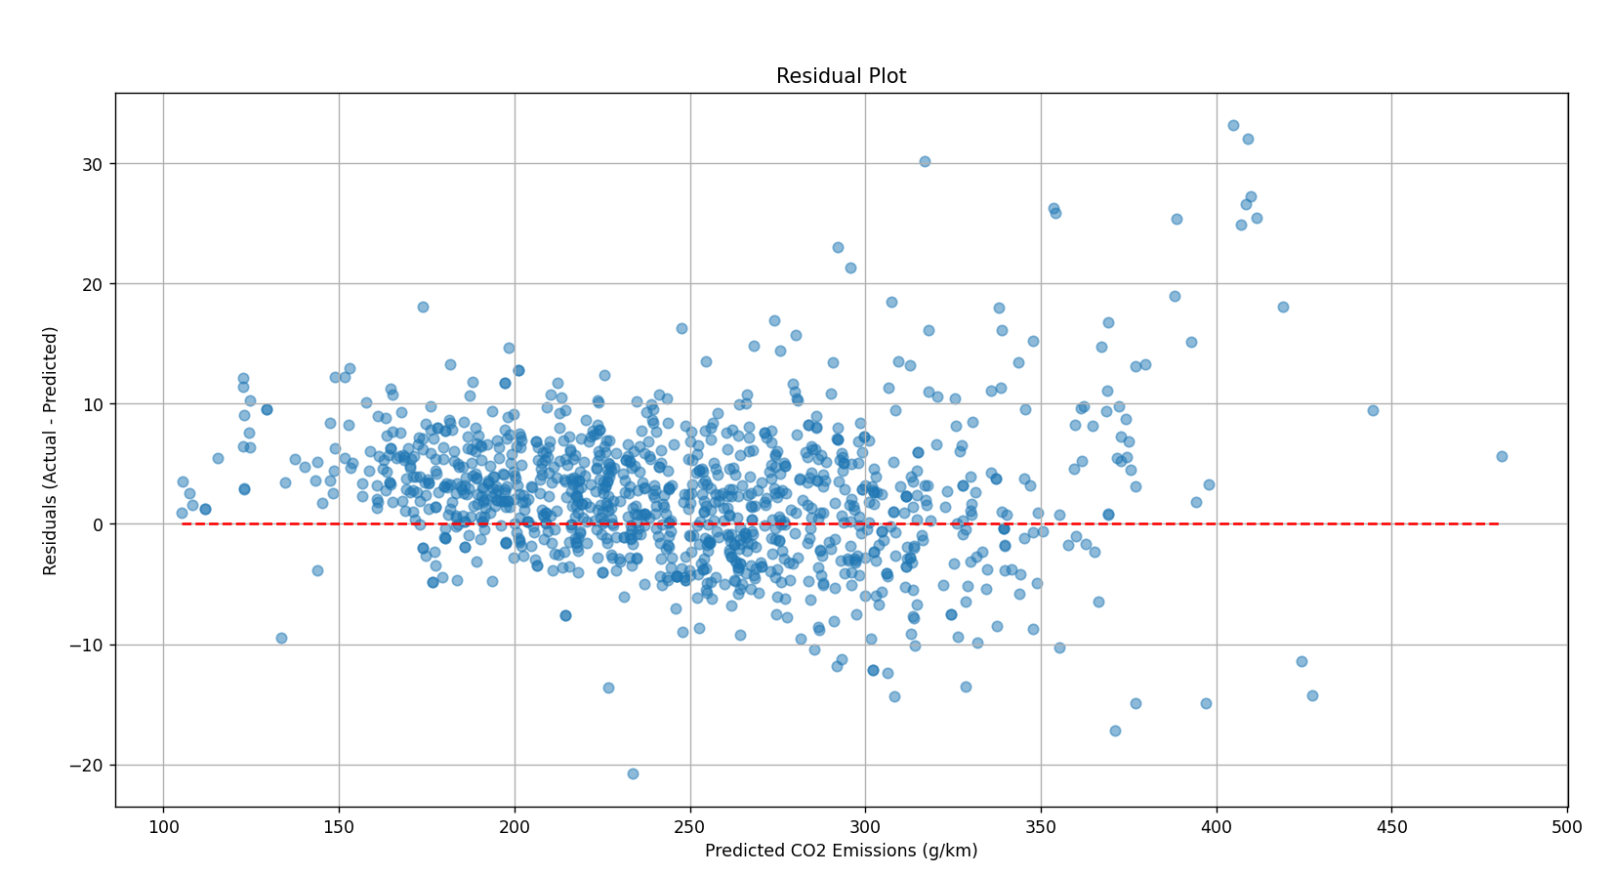
Results
Notes:
Residuals (Actual - Predicted) are mostly randomly scattered around the zero line, suggesting no significant systematic bias in the model's predictions.

Slide 18
Conclusion & Future Work
Conclusion:
The developed deep learning model demonstrates strong performance in predicting CO2 emissions for vehicles based on the provided Canadian dataset.
Achieved a Test MAE of 4.59 g/km, indicating high accuracy.
EDA revealed key features like fuel consumption metrics, engine size, and cylinders are highly correlated with CO2 emissions.
Preprocessing techniques (scaling, one-hot encoding) and model regularization (dropout, early stopping) were effective.
Notes:
Need to discuss about :
Final thoughts
How the model can be improved or scaled

Slide 19
Conclusion & Future Work
Future Work:
Feature Engineering: Explore interaction terms (e.g., Engine Size * Cylinders) or polynomial features.
Advanced Categorical Encoding: Investigate alternatives to one-hot encoding for high-cardinality features like Model (e.g., target encoding, embedding layers).
Hyperparameter Tuning: Systematic optimization of learning rate, number of layers/neurons, dropout rates, and batch size using techniques like KerasTuner or Optuna.
Alternative Models: Compare performance with other machine learning algorithms (e.g., Gradient Boosting Machines like XGBoost or LightGBM, Random Forest).
Error Analysis: Deeper dive into instances where the model performs poorly to identify patterns or data issues.
Deployment: Consider pathways for deploying the model for real-world use (e.g., as a web API).
Notes:
Need to discuss about :
Final thoughts
How the model can be improved or scaled

Slide 20
References
Dataset: https://www.kaggle.com/datasets/karomatovdovudkhon/co2-emissions-canada
Libraries:
Pandas: https://pandas.pydata.org/
NumPy: https://numpy.org/
Scikit-learn: https://scikit-learn.org/
TensorFlow: https://www.tensorflow.org/
Keras: https://keras.io/
Matplotlib: https://matplotlib.org/
Seaborn: https://seaborn.pydata.org/
http://jmlr.org/papers/v15/srivastava14a.html
https://arxiv.org/abs/1604.06737
https://www.sciencedirect.com/science/article/abs/pii/S1361920921000651?via%3Dihub
https://papers.nips.cc/paper/2017/hash/6449f44a102fde848669bdd9eb6b76fa-Abstract.html
Notes:
Need to discuss about :
Papers, datasets, collaborators, tools used

Slide 21
Thank You

